Slide 1


AI Global Impact
Nithyasri Ramdas

Slide 2
Index
objectives
Data set
Visualization
Dashboard
Challenges
Conclusion
06
05
04
03
02
01

Slide 3
Objective
The goal is to analyze global patterns of Artificial Intelligence (AI) adoption, its impact on industries and countries, public trust, and regulatory status using interactive Tableau dashboards. The goal is to understand how AI is shaping economies, employment, and human interaction across the globe.

Slide 4
Data set
Dataset Name: Global_AI_Content_Impact_Dataset.csv
Source: Kaggle
Key Columns:
Country
Industry
Regulation Status
Top AI Tools Used
Year
Ai Adoption Rate (%)
AI- Generated Content Volume (TBs/Year)
Consumer Trust in AI (%)
Human=AI Collaboration Rate (%)
Job Loss Due to AI (%)
Market Share of AI(%)
Revenue Increases Due to AI (%)
Latitude, Longitude

Slide 5
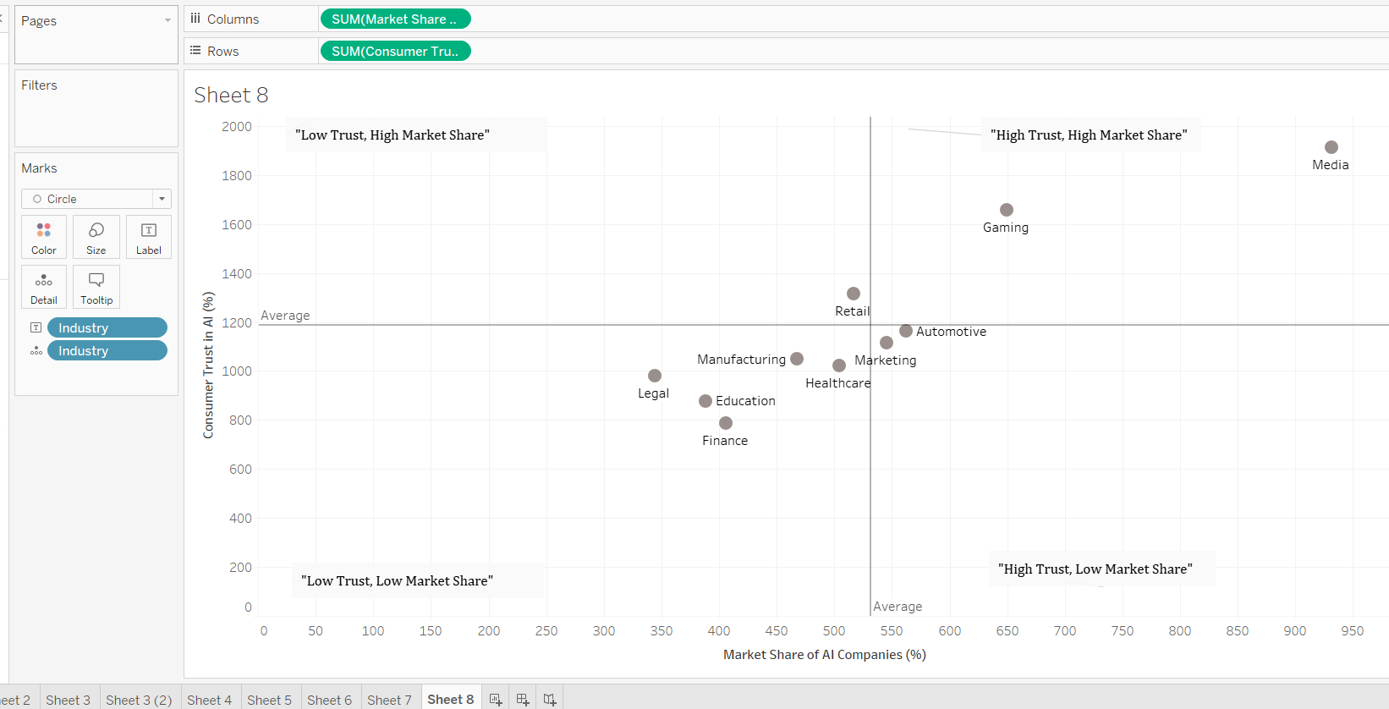
Visualization

Slide 6
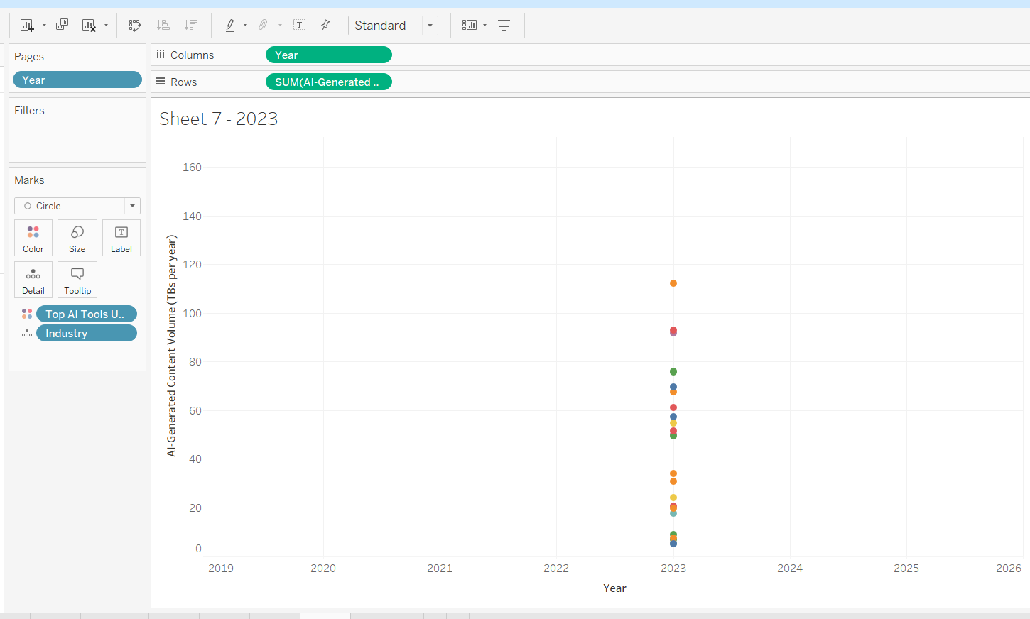
Visualization

Slide 7
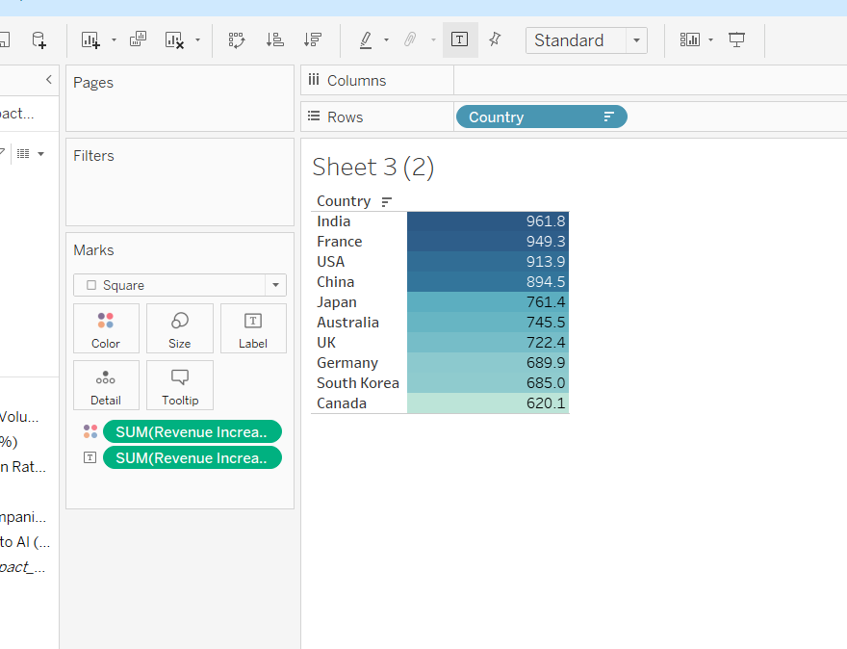
Visualization

Slide 8
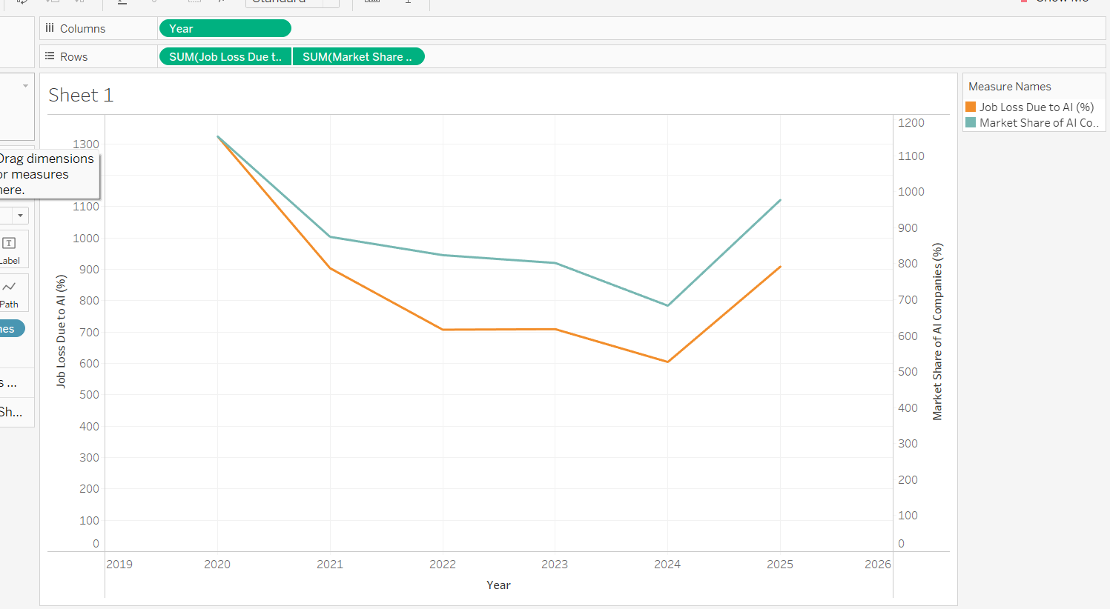
Visualization

Slide 9
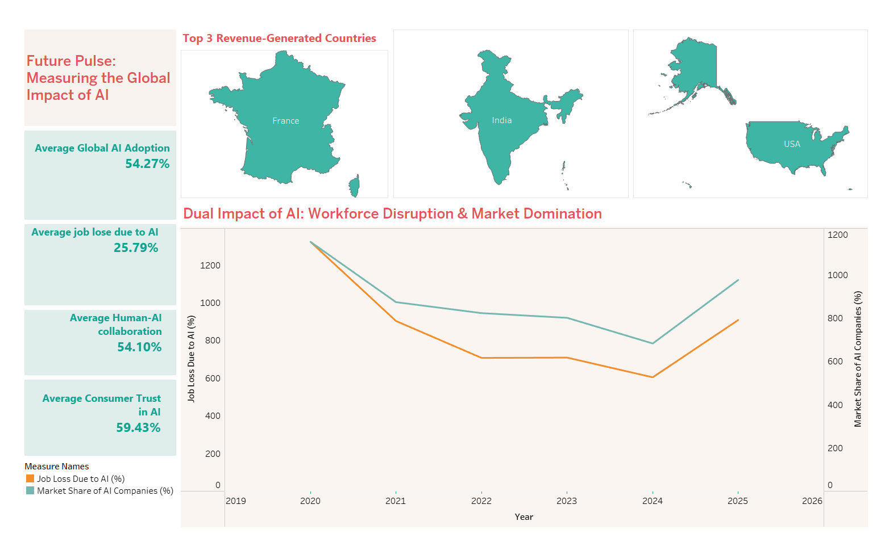
Dashboard

Slide 10
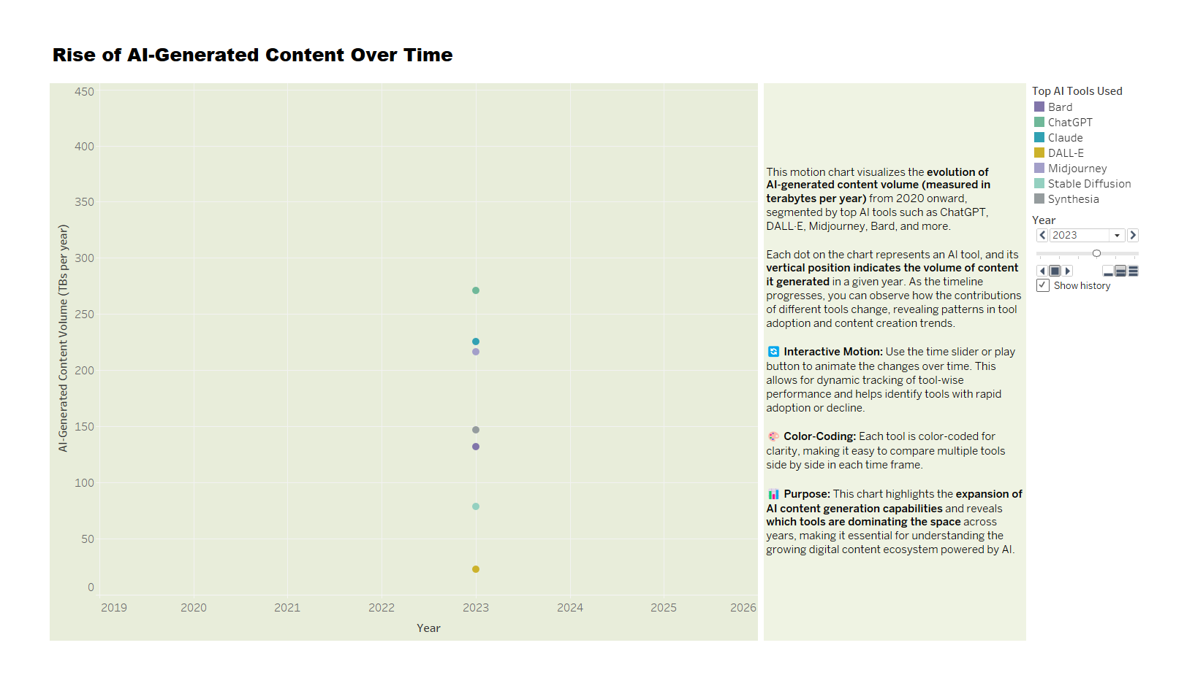
Dashboard

Slide 11
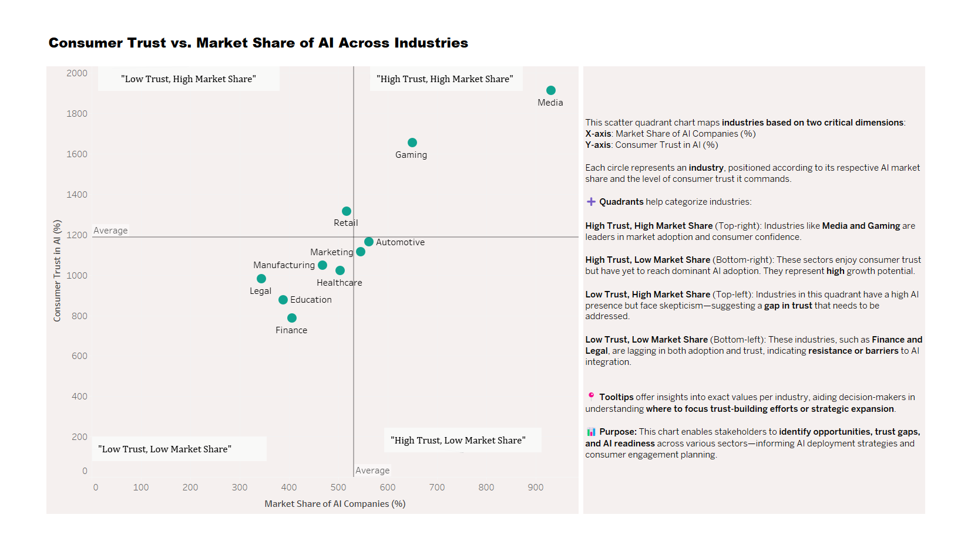
Dashboard

Slide 12
Challenges faced
During the "AI Global Impact" project, one major challenge was sourcing authentic and diverse data across countries and industries. Visualizing abstract AI concepts and ensuring balanced, unbiased interpretation of both positive and negative impacts required careful metric selection, thoughtful storytelling, and creative design in Tableau.

Slide 13
Conclusion
The AI Global Impact project helped uncover how artificial intelligence is influencing different parts of the world in unique ways. Using Tableau, we visualized key trends in AI adoption, regional growth, and emerging challenges. The project highlights the importance of using AI responsibly and
ensuring that its benefits are shared fairly across all regions and sectors.

Slide 14
THANK YOU

